Slide 1



Integrated Program in Business Analytics
Prediction of Attrition in Credit Cards Using ML Model
Batch 17: Group K

Slide 2
Agenda
Business Problem and Objectives
Executive Summary
Data Overview and Key Business Assumptions
Data Preparation and Pre-processing
Sanity checks, treatment and transformations for analytical dataset preparation
Exploratory Data Analysis
Key Business Findings and Insights
Model Development and Validations
Model comparisons on key scoring metrics and model finalization
Dashboarding
Businesss Recommendations

Slide 3



Decoding the Challenge: The Alarming rise of Credit Card Attrition
Business Problem: In recent years, credit card attrition has emerged as an issue of significant concern for the banking sector. It has a significant impact on profitability, given that the cost of acquiring new customers is higher than that of retaining existing customers. With increasing number of users and offers available in the market, it is getting difficult to retain customers, it is becoming difficult to prevent a customer from transitioning from one card to other. Hence, we are building ML model which will be helpful to find potential customer for attrition and how can we prevent that from happening, which will save a lot of bank’s costs.
Objective:
Identify the Customer Planning for Attrition and the attributes of the best customer for the bank?
Understand the Spending Habits of Male and Female Credit Card Owners by Age Group
Highlight the Impact of Marriage, Education Level, and Income on Credit Card Ownership
The main objective of this analysis is to build a machine learning model to predict customer attrition for a bank.
The benefits of this analysis include reducing customer churn, improving customer satisfaction, and increasing revenue for the bank.
By accurately identifying the customers who are most likely to leave, the bank can develop targeted retention strategies that address the specific needs and concerns of those customers, which can ultimately lead to increased loyalty and profitability for the bank.

Slide 4
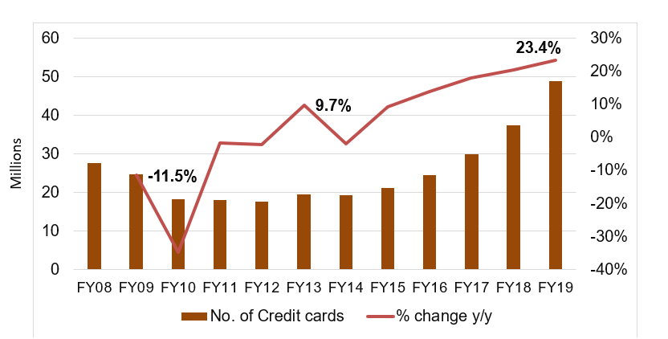
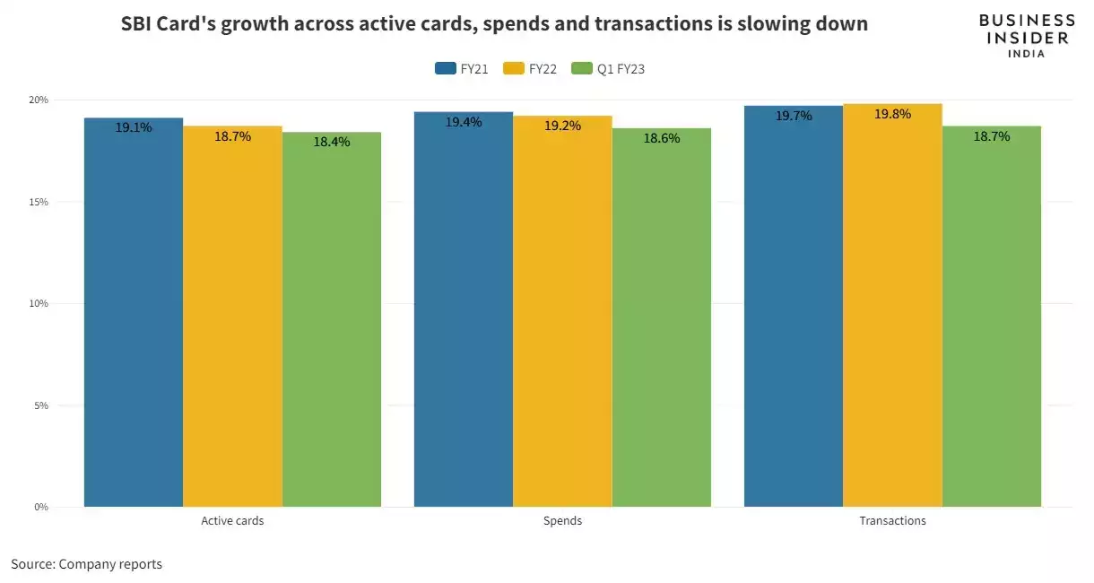
Navigating Credit Card Attrition: A Stastistical Overview
Background on Credit cards:
Data from the Reserve Bank of India (RBI) show that credit card use in India has ticked up significantly over the past year. In April 2023, India had over 8.6 crore (86 million) credit cards, up 15% from 7.5 crore (75 million) in April 2022. This number could hit the 10-crore (100 million) milestone by early 2024.
The below chart comparison and data shows us that the sales of credit cards has been increasing but the active users have been decreasing YoY, this implies that people are switching fast from one credit card to another due to competitive market.
The lower the churn rate, the better is the long-term profit for any business. Credit card is a good source of revenue generation for the bank through fees and transaction charges and interest, it provides stickiness in the customer overall portfolio.
Growth in the count of Credit Card numbers contrasts with a decline in active users
Source: Reserve Bank of India, compiled by The Financial Pandora
Source: Business Insider India

Slide 5
Establishing a Data Dictionary: Defining Key Terms and Elements
S.No. | Column name | Description | Datatype
1 | CLIENTNUM | Unique identifier for each customer | Integer
2 | Attrition_Flag | Flag indicating whether or not the customer has churned out | Boolean
3 | Customer_Age | Age of customer in Years | Integer
4 | Gender | Gender of customer | String
5 | Dependent_count | Number of dependents that customer has | Integer
6 | Education_Level | Education level of customer | String
7 | Marital_Status | Marital status of customer | String
8 | Income_Category | Income category of customer | String
9 | Card_Category | Type of card held by customer | String
10 | Months_on_book | Period of relationship with the bank | Integer
11 | Total_Relationship_Count | Total no. of products held by the customer | Integer
12 | Months_Inactive_12_mon | Number of months customer has been inactive in the last 12 months | Integer
13 | Contacts_Count_12_mon | Number of contacts customer has had in the last 12 months | Integer
14 | Credit_Limit | Credit limit of customer | Integer
15 | Total_Revolving_Bal | The balance that carries over from one month to the next | Integer
16 | Avg_Open_To_Buy | The amount left on the credit card to use (Average of last 12 months) | Integer
17 | Total_Trans_Amt | Total Transaction Amount (Last 12 months) | Integer
18 | Total_Trans_Ct | Total Transaction Count (Last 12 months) | Integer
19 | Total_Amt_Chng_Q4_Q1 | Ratio of the total transaction amount in 4th quarter to the 1st quarter | Integer
20 | Total_Ct_Chng_Q4_Q1 | Ratio of the total transaction count in 4th to the 1st quarter | Integer
21 | Avg_Utilization_Ratio | Represents how much of the available credit the customer spent | Integer
We possess information on 10,127 customers, encompassing 16 numerical and 5 categorical attributes.
The target variable, "Attrition Flag," contains Boolean values, indicating that the problem at hand is a Classification problem.
Relation b/w Avg_Open_To_Buy, Credit_Limit and Avg_Utilization_Ratio:
( Avg_Open_To Buy / Credit Limit ) + Avg Utilization Ratio = 1

Slide 6
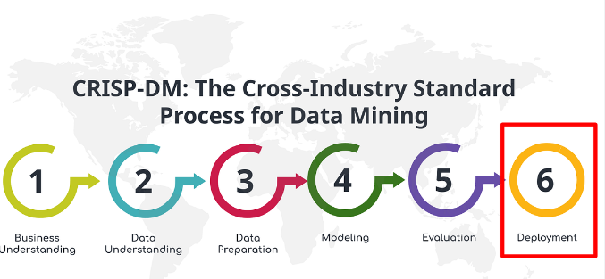
Draft Approach to problem
EDA
Missing Value
Treatment
Data Balancing
Performance Evaluation
Univariate Analysis
ML Model
Bivariate Analysis

Slide 7
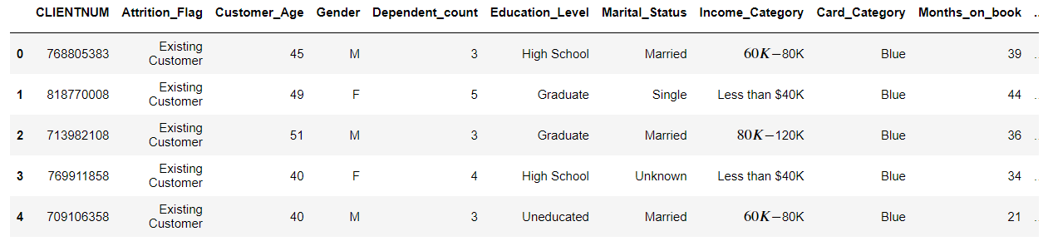
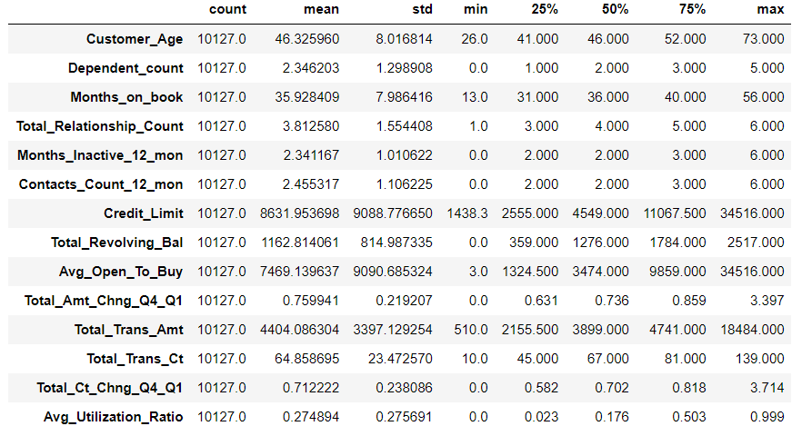
Data Cleaning
Data top view
CLIENTNUM will be dropped as it has no information
There are no duplicates in data set
Description of data

Slide 8
Distribution of data based on Attrition and Card Category
Data is mildly imbalanced with 16% data on Attrited customer
Blue Card seems favorite to customers.

Slide 9
Missing/Unknown Data Detection
Three categorical columns in the dataset, namely Education level, Marital Status, and Income Category, contain missing values.
Due to the substantial percentage of missing values and the fact that they don't pertain to the same customers, removing them is not a suitable option. Therefore, we will employ a predictive approach to determine the values for the unknowns.
Education Level has 14.7% Unknowns
Marital status has 7.4% Unknowns
Income category of 11% customers are unknown

Slide 10
Imputing Missing Values with Random Forest Classification
Random Forest classifier is used to predict the Unknown’s using other variables
Example is shown in below plots. Unknown’s in Education level are mostly assigned to Graduate.
Similar treatment is done for Marital Status and Income Category.
Missing data treatment

Slide 11
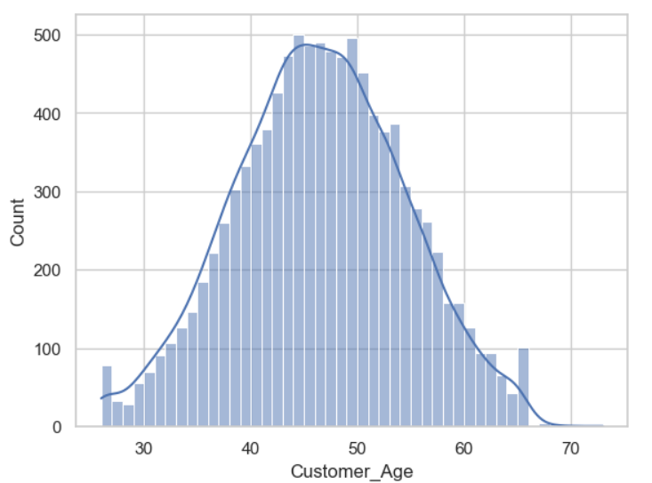
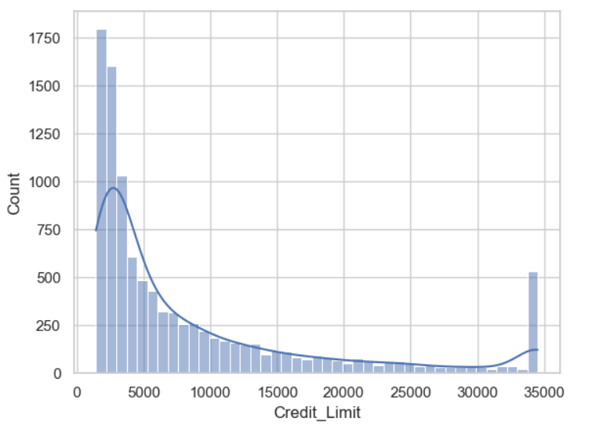
Distribution of continuous variables
Histograms are used to understand distribution of continuous variables in data.
Customer Age and Months on Book are normally distributed.
Credit Limit, Total Transaction Amount are positively skewed.
Examples of Customer Age and Credit Limit are shown in below plots.

Slide 12
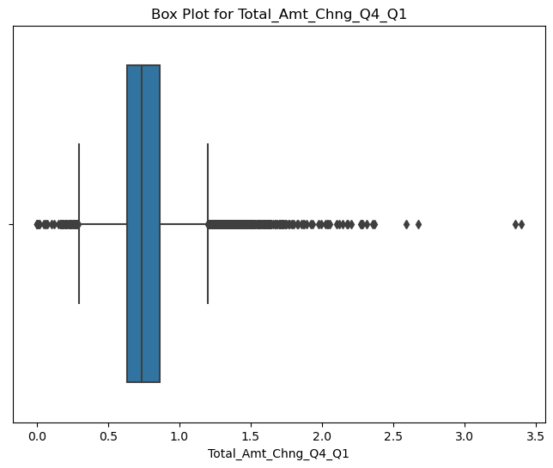
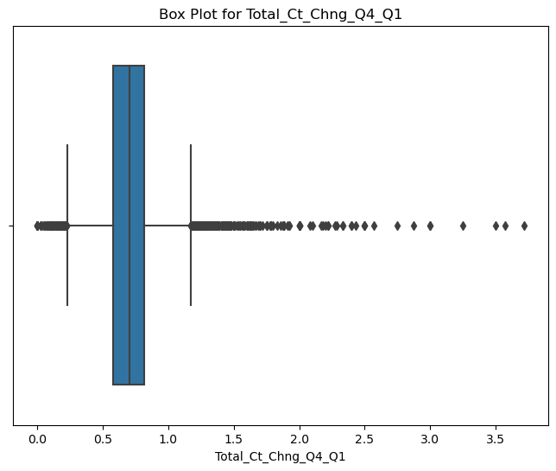
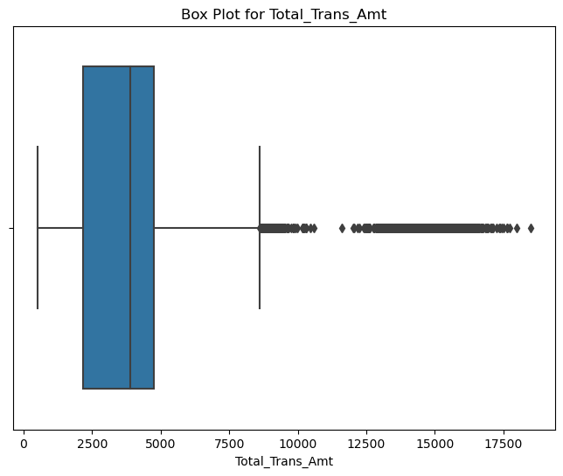
Outlier Analysis: Extreme Outliers Detected
Outlier Detection shows in:
Total amount changed from quarter 4 to quarter 1
Total count changed from quarter 4 to quarter 1
Total transaction amount
Credit limit out of the total number of variables.
Outlier Treatment:
Since the outliers detected are within acceptable range for the respective variable, Outliers are retained in the data

Slide 13
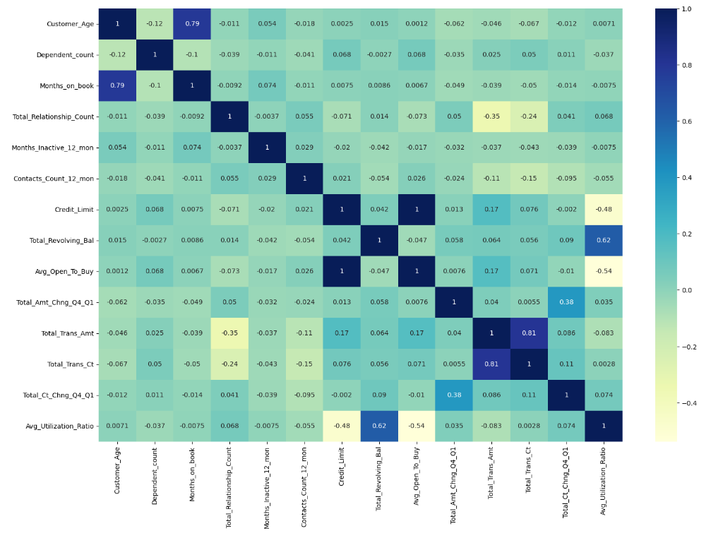
Interpreting Correlation Matrix: Insights into Strong Relationships among 3 Variables
Months on book is well co-related with Customer Age
Credit Limit is well explained by Avg_Open_To_Buy
Total_Trans_Ct is well co-related with Total_Trans_Amt
The highly correlated variables have been dropped from further analysis.
The threshold considered for the correlation matrix is 0.75.
Notably, no strong negative correlations were identified in the dataset, indicating a lack of inverse relationships among the variables.

Slide 14
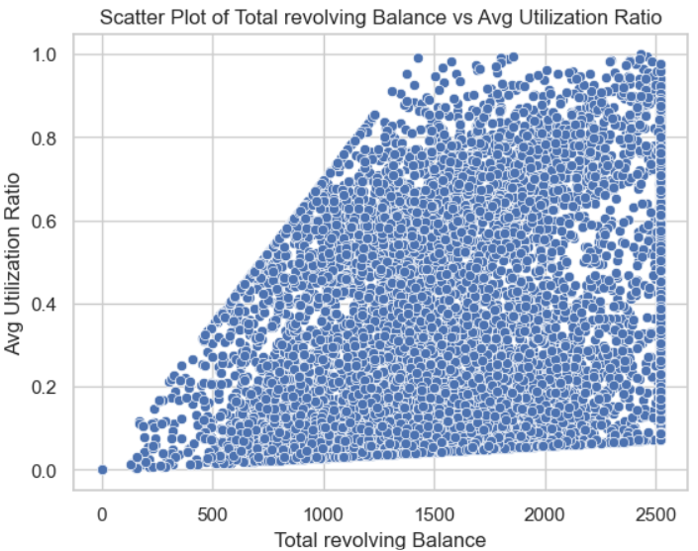
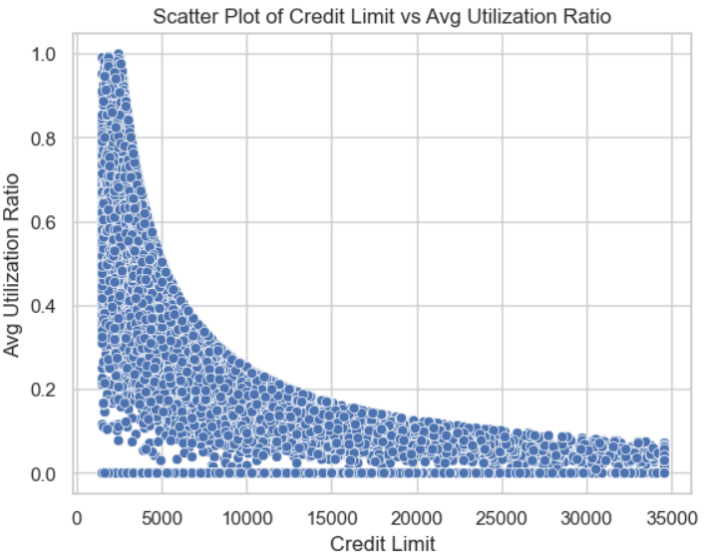
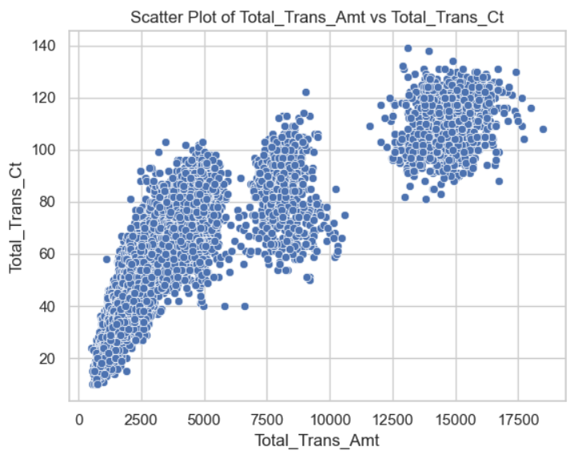
Bivariate Analysis – Continuous variables
A
Scatter plot can be used to understand relation between continuous variables.
Avg Utilization ratio and Total revolving Balance has positive correlation.
Avg Utilization ratio and Credit Limit has negative relation.
Total transaction count and total Transaction amount has positive correlation.
B
C
A
B
C

Slide 15
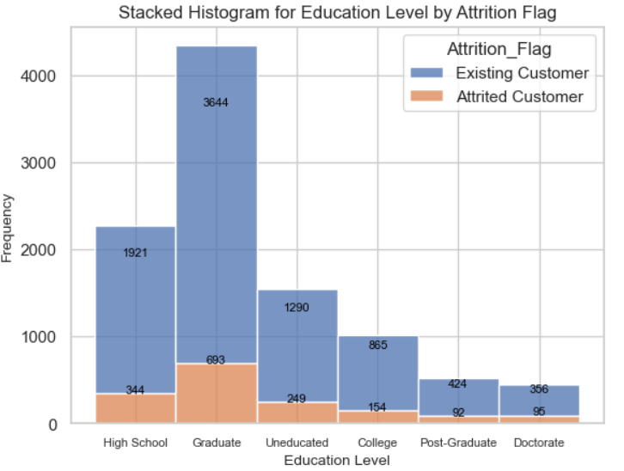
Bivariate Analysis – Categorical variables
Stacked histogram plot can be used to understand relation between categorical variables.
Below plot shows Education level histogram.
It can be seen that with increase in education level, attrition percentage increases.
It is good for bank to focus on Graduate level customers as attrited customer are more in them.

Slide 16
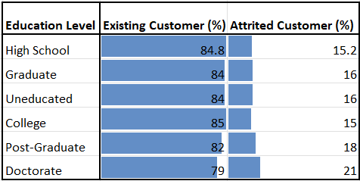
Bivariate Analysis – Hypothesis Testing
As seen in the previous slide, the same relationship could be confirmed by the Chi square left-tail test.
The variations in Education level contribute to differences in attrition rates.
Type of Test | Chi Square test of independence
Hypothesis | H0 : There is no impact of education level on attrition.
 | H1 : Attrition is affected by education level
Variables | 1. Education Level(Categorical Variable)
 | 2. Attrition Flag(Categorical Variable)
P value of Test | 0.04
Results | As P ≤ 0.05, we reject Ho Education level has effect on attrition

Slide 17
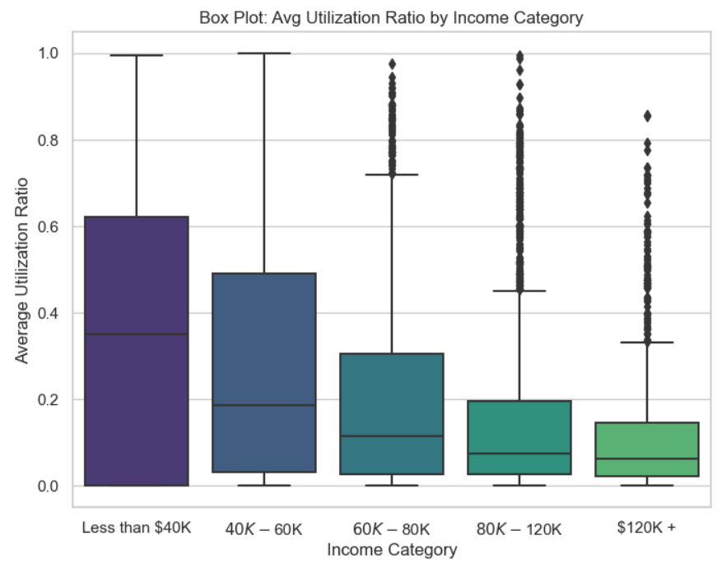
Bivariate Analysis – Hypothesis Testing
As the income category increases, the average utilization ratio decreases.
Bivariate Analysis Using Box Plot confirms that there is exists a statistically significant difference in the Mean Utilization Ratio and the income categories.
Type of Test | ANOVA
Hypothesis | H0 : Avg utilization ratio is not affected by income category
 | H1 : Avg utilization ratio is affected by income category
Variables | 1. Avg Utilization Ratio(Continuous Variable)
 | 2. Income Category(Categorical Variable)
P value of Test | 1.1387012610668134e-40
Results | As P ≤ 0.05, we reject Ho Income Category has effect on Average utilization ratio

Slide 18
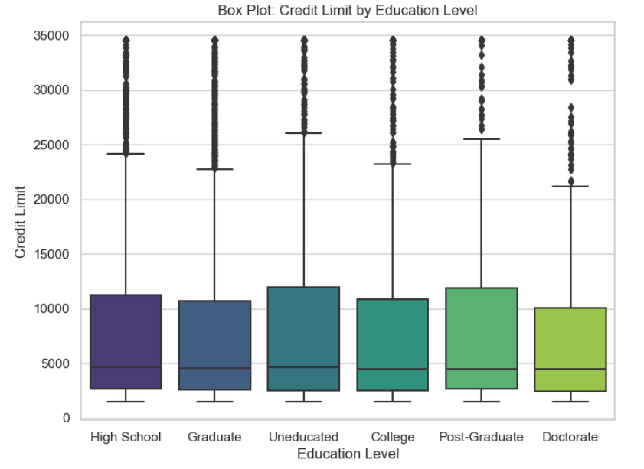
Bivariate Analysis – Hypothesis Testing
There is no relation between Education level and Credit Limit. Credit limit is approximately same for all education levels, however, there are some outliers.
Bivariate Analysis Using Box Plot confirms the same that there is doesn’t exist a statistically significant difference in the Mean Credit Limit and Education Level.
Type of Test | ANOVA
Hypothesis | H0 : Credit limit is not affected education level
 | H1 : Credit limit is affected education level
Variables | 1. Education Level(Categorical Variable)
 | 2. Credit Limit(Continuous Variable)
P value of Test | 0.37
Results | As P ≥ 0.05, we accept Ho Credit limit is same for all education levels

Slide 19
Task category
Problem
Regression
Classification
Clustering
Logistic regression
Decision tree Classifier
Boosting
Bagging classifier
Random forest classifier
Gradient boosting
Note: Models highlighted with green color are used for machine learning

Slide 20
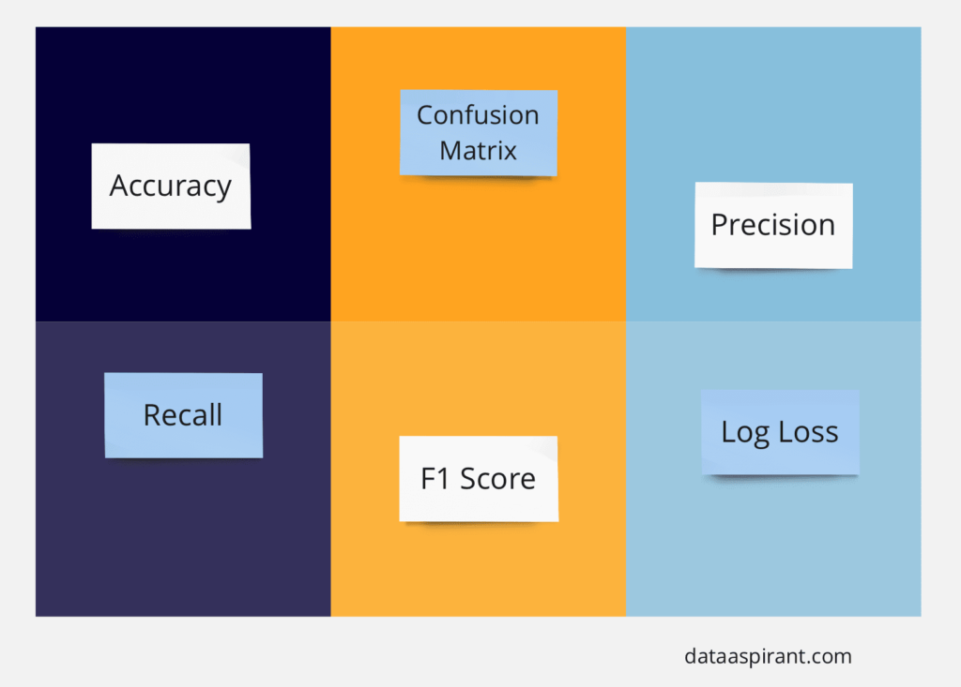
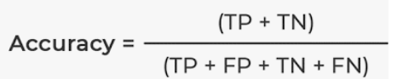
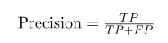
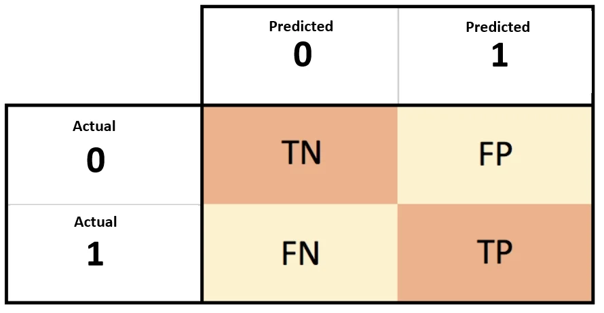
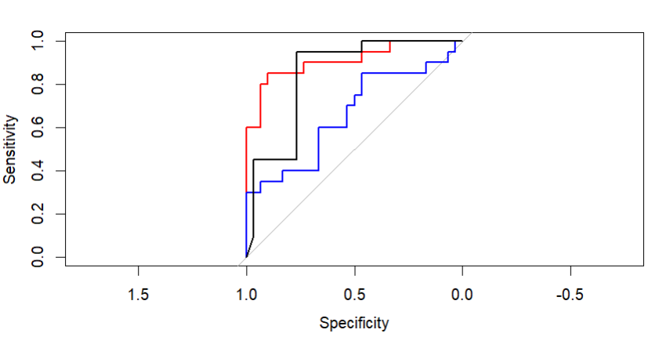
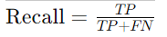
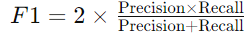
Evaluation Metrics of Classification model
1
Confusion Matrix: A confusion matrix provides a summary of correct and incorrect predictions broken down by each class. It consists of four quadrants: True Positive (TP), True Negative (TN), False Positive (FP), and False Negative (FN).
2
Accuracy: It measures the overall correctness of the model's predictions and is calculated as the ratio of correct predictions to the total number of predictions.
3
Precision: It is a measure of how accurate a model’s positive predictions are. It is defined as the ratio of true positive predictions to the total number of positive predictions made by the model.
AUC-ROC curve: Receiver Operating Characteristic (ROC) curve is a graphical plot that illustrates the diagnostic ability of a binary classifier system. AUC provides an aggregate measure of performance across all possible classification thresholds.
F1 Score: It is the harmonic mean of precision and recall, providing a balance between the two metrics.
4
Recall (Sensitivity): It measures the proportion of true positive predictions among all actual positive instances.
5
6

Slide 21
Evaluation Metrics of Classification model
Problem to solve: Prediction of attrition of credit card customers
It is important to predict maximum correct customers to attrite than customers those are going to stay.
Hence, Recall will be important criteria to select the best ML model
 | Existing Customer | Attired Customer
Existing Customer | TN | FP
Attired Customer | FN | TP
Recall

Slide 22
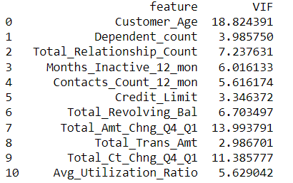
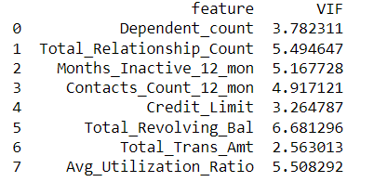
Multicollinearity
Logistic regression:
Multicollinearity: It refers to high correlation between two or more predictors
Multicollinearity is found out by calculating Variance Inflation Factor (VIF). VIF should be less than 9 for predictors. Predictors with VIF more than 9 are highly correlated and needs to be dropped.
VIF
VIF
After dropping predictors with VIF>9
Note: Features highlighted with red square have been removed due to multicollinearity for logistic regression

Slide 23
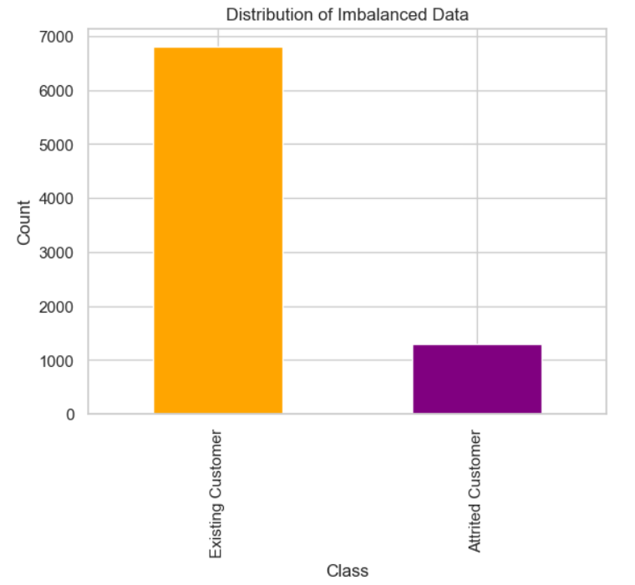
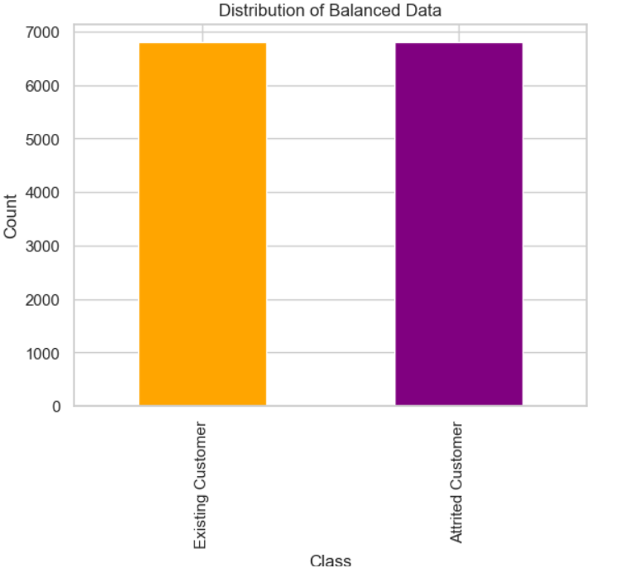
Imbalanced vs Balanced data
Imbalanced data vs Balanced data
Customer data is imbalanced data as only 16% data is of attrition customer
Imbalanced data poses problem of ML model performing poorly on minority class and becoming biased towards majority class
Build all ML models on balanced data

Slide 24
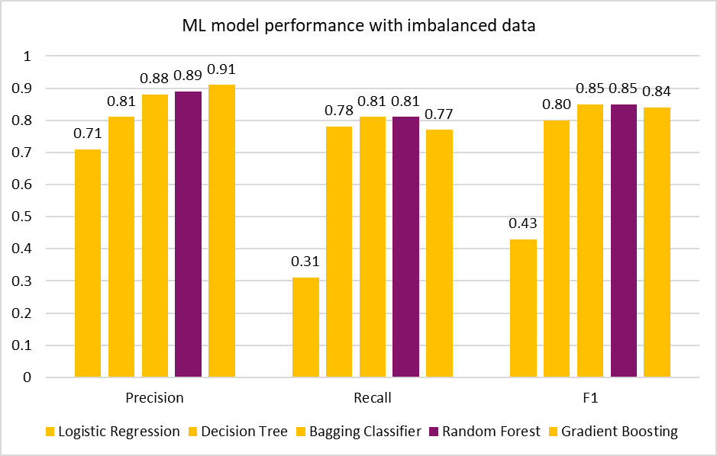
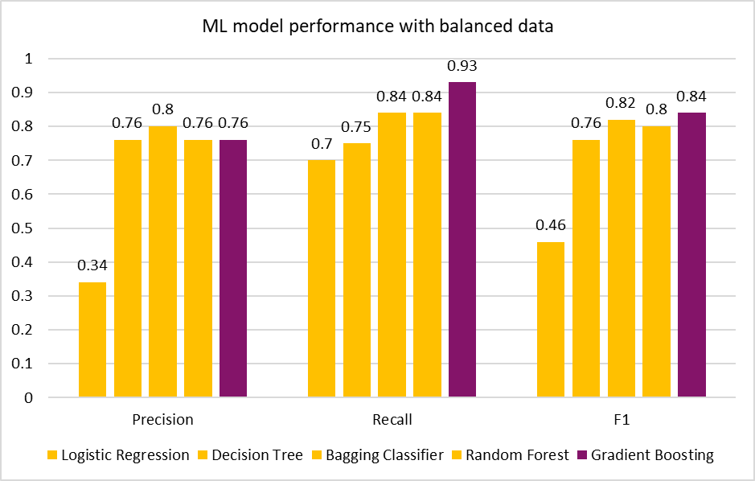
Machine learning models - Performance
ML model performance with imbalanced data
ML model performance with balanced data
With balanced data, recall values increases compared to imbalanced data
Gradient boosting model with balanced data has recall value of 93% with precision of 76%
Random forest model with imbalanced data has recall value of 81% with precision of 89%
Since, accurate prediction of attriting customers from actual customers going to attrite, Gradient boosting model is selected

Slide 25
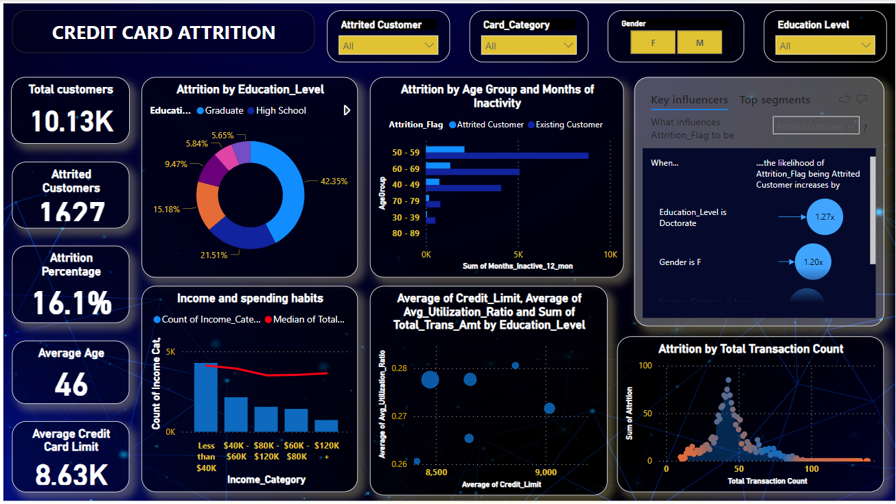

Slide 26
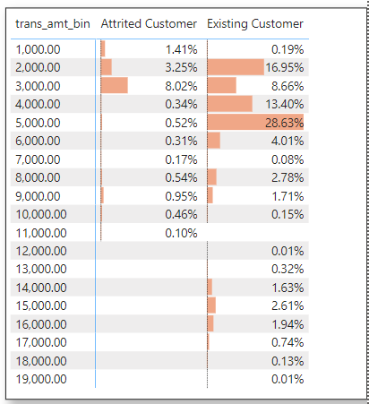
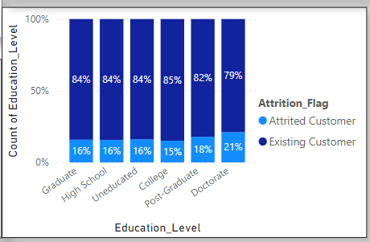
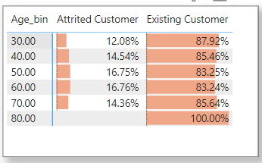
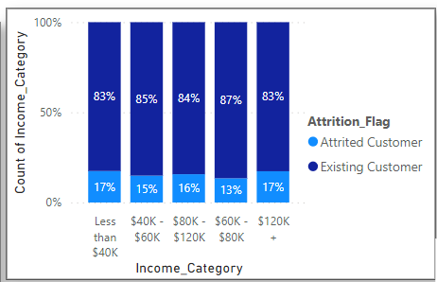
Business Recommendations: Target Customers
Post-Graduate and Doctorate customer
Transaction amount less than 3000
Income Category: Less than $40K
Customer age: 50-60 years

Slide 27
Thank You

